Slide 1
Forecasting the Future: Machine Learning Meets the Stock Market
December 16, 2024
Sebastian, Jonathan, Elizabeth, Sheryle
Notes:
Jonathan

Slide 2
Project Overview
Objective:
Leverage advanced machine learning models to predict investor risk tolerance from text responses and provide personalized investment portfolio recommendations tailored to individual risk profiles.
Key Questions:
How can natural language processing be used to classify investors’ risk tolerance?
How can investment portfolios be effectively aligned with individual risk profiles?
Notes:
Jonathan

Slide 3

Machine Learning Models
Sentiment Analysis - Machine Learning Model
Investment Strategy Model
Notes:
Jonathan
Machine Learning Models for Investment Decision-Making
Sentiment Analysis - Machine Learning Model - to help answer the first question How can natural language processing be used to classify investors’ risk tolerance?
Purpose: Helps investors identify the best investment options based on their risk tolerance and preferences.
How it Works: Analyzes the investor’s responses to a set of questions and recommends an investment portfolio based on the investor’s risk tolerance
Investment Strategy Model: - to help answer the second question How can investment portfolios be effectively aligned with individual risk profiles?
Purpose: Assists investors in selecting appropriate investment strategies that align with their individual risk tolerance.
How it Works: Suggests strategic asset allocations (e.g., conservative, balanced, aggressive) to create a portfolio that matches the investor's financial goals and risk appetite.
What strategy to follow

Slide 4

Sentiment Analysis: Machine Learning Models
DistilBert- Hugging Face model
Smaller, lighter, more efficient version of the BERT(Bidirectional Encoder Representations Transformers)-Google model
Maintains higher accuracy than BERT
Why use DistilBert for Sentiment Analysis?
Understanding of language patterns for our risk assessments
Text tokenization: sentences are tokenized into key words
Efficient: fast inference
Sentence Transformers
Specialized model for sentence-level embeddings
Comparing meanings
Matching answers with relative ranking 1-5 (no risk- risky)
Notes:
Score - represents the overall “tone” of the answer // percentage = the model’s confidence score of the sentiment analysis

Slide 5
Sentient Analysis & Classifiers
Questionnaire
Would you accept significant losses for the chance of high returns?
How often do you invest in growth focused, volatile stocks?
How do you typically handle market downturns?
Do you prioritize growth over stability in your portfolio?
How reliant are you on professional advice for investment decisions?
How much do you enjoy seeking high-risk investment opportunities?
What is your main goal for your portfolio?
How do you view market fluctuations?
Do you frequently invest in speculative or emerging industries?
Do you focus more on diversification or on maximizing returns?
Generated dataset of 200 investors with answers, which are then labeled with their risk tolerance level (1-5).
5 of the questions are used to predict risk tolerance by analyzing the users responses.
Notes:
-super basic
-we can adjust/add questions

Slide 6
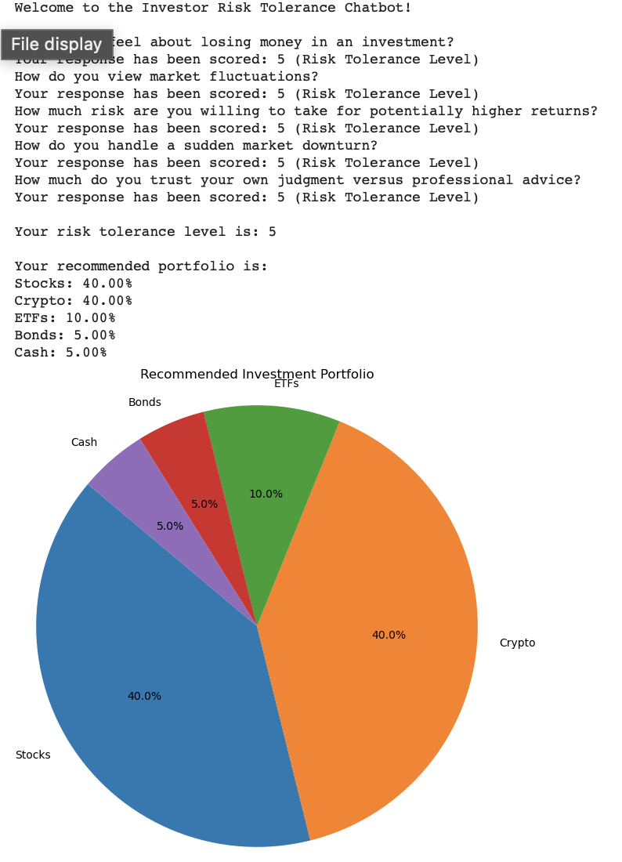
Investment Strategy Model
Portfolio Recommendation:
A diversified portfolio is recommended with asset allocation
Based on investors risk tolerance level assigned in questionnaire
Portfolio is adjusted depending on risk level
Ranges from 1: conservative- 5 more aggressive
Conservative: higher bond and cash allocations
Aggressive: More equity and cryptocurrency investments
Notes:
Conservative = risk-averse
Key words in the response are used to classify the risk profile of the investor
The response is also put into the Hugging Face Sentiment Analyzer to obtain a sentiment score
This scores the overall “tone” of their response and their “feeling” towards investments

Slide 7
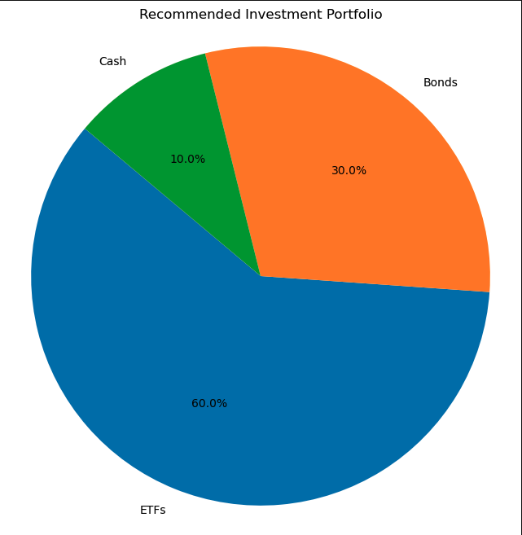
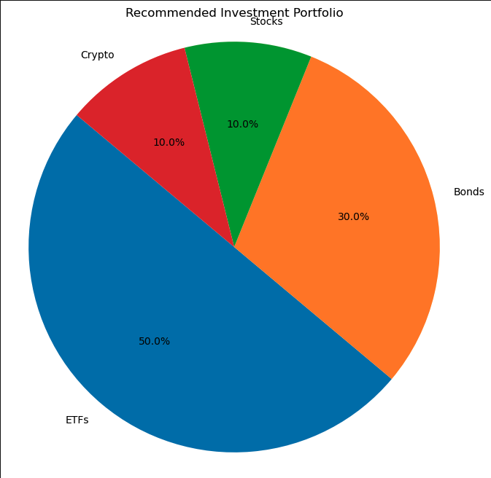
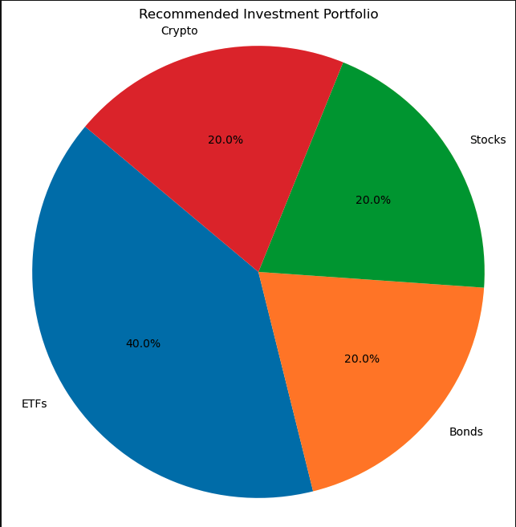
Example Portfolio Recommendations of Risk Levels 1-5
Risk Level 1
Risk Level 2
Risk Level 3

Slide 8
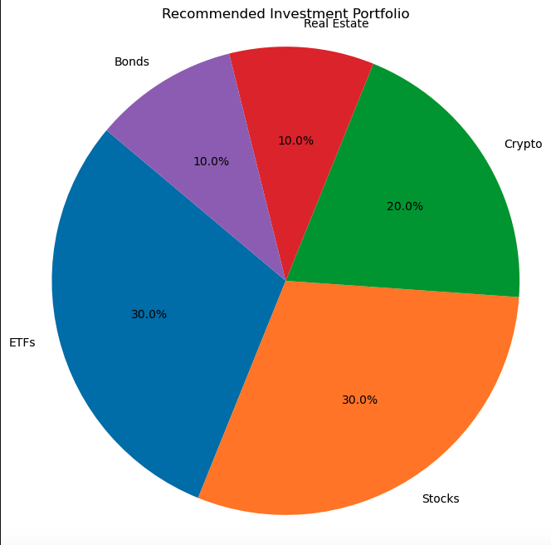
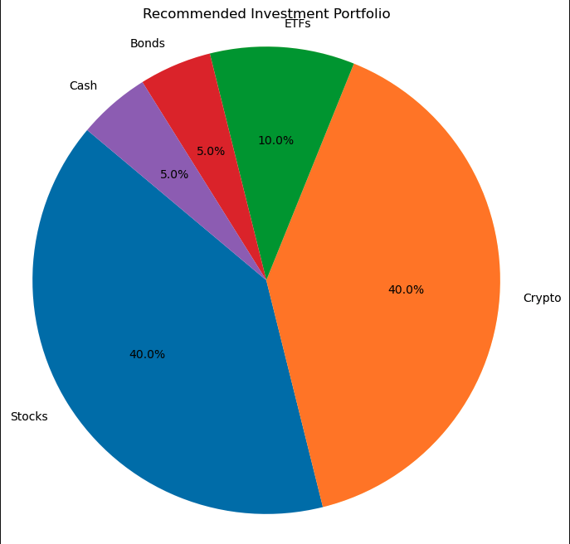
Example Portfolio Recommendations of Risk Levels 1-5
Risk Level 4
Risk Level 5

Slide 9
Let’s try it out!

Slide 10
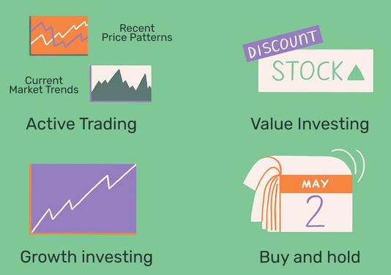
Machine Learning 2: Reviewing strategies
Active Trading
Value investing
Growth investing
Buy and Hold
Notes:
Value investing is an investment strategy that involves picking stocks that appear to be trading for less than their intrinsic or book value.
Growth investors seek companies that offer strong earnings growth while value investors seek stocks that appear to be undervalued in the marketplace. Because the two styles complement each other, they can help add diversity to your portfolio when used together

Slide 11

Data collection and libraries
CSV data was downloaded from stocksanalysis.com for the last five years for various tickers
Libraries
numpy (np): Used for numerical operations.
pandas (pd): Used for handling and manipulating data in DataFrame format.
matplotlib.pyplot (plt): Used for plotting graphs.
warnings: Used to filter out warnings during execution.
train_test_split: From Scikit-learn, used to split data into training and testing sets.
tensorflow.keras is used to build the LSTM model.
Technical Analysis ta library is used to compute technical analysis indicators like SMA, EMA, RSI, MACD, and more.
Notes:
Adjusted closing price (ACP) is a stock's closing price that's been adjusted to account for corporate actions like stock splits, dividends, and additional shares. It's a more accurate reflection of a stock's value than the closing price alone

Slide 12
Data Loading, Processing, and Feature Preparation
Load data: NDAQ is read from a CSV file.
Process data:
The 'Date' column is converted to a datetime index and dropped
Created two columns to show the difference between the high and low and open and closing price for the day
Prepare the Features (X) and Target (y)
X is the feature set, containing three independent variables: Open_minus_Close, High_minus_Low, and Close.
y is the target variable, which represents the trading signal:
1 (Buy) if the next day's closing price is higher than today's closing price.
0 (Sell) if the next day's closing price is lower or equal.
Notes:
Train the Machine Learning Model
A Random Forest classifier is used to model the relationship between the features and the target.
The model is trained on the training data (X_train, y_train).
Trading Strategy
The Position column is created, showing when the model's prediction changes (from 0 to 1, or from 1 to 0). This indicates a change in the trading position (buy/sell).
Returns: Daily returns (percentage change in the closing price).
Strategy_Returns: The returns generated by following the trading strategy. This is calculated by multiplying the shifted position (previous day's action) by the daily return.
Key Points and Considerations:
Lookahead Bias: The model uses tomorrow's closing price to predict today’s actions, which is unrealistic in real trading.
Overfitting Risk: The model may be overfitted to the historical data, making it less generalizable to future data.
Transaction Costs: The strategy doesn't account for transaction costs or slippage, which would likely reduce actual returns.
Real-world Testing Needed: Additional validation, such as testing on out-of-sample data or implementing cross-validation, is necessary.
Performance: The strategy outperforms the buy-and-hold approach significantly, but this needs further testing and refinement for practical use.
In summary, while the machine learning strategy shows great promise, it requires a deeper analysis and testing before it could be considered for real-world trading.

Slide 13
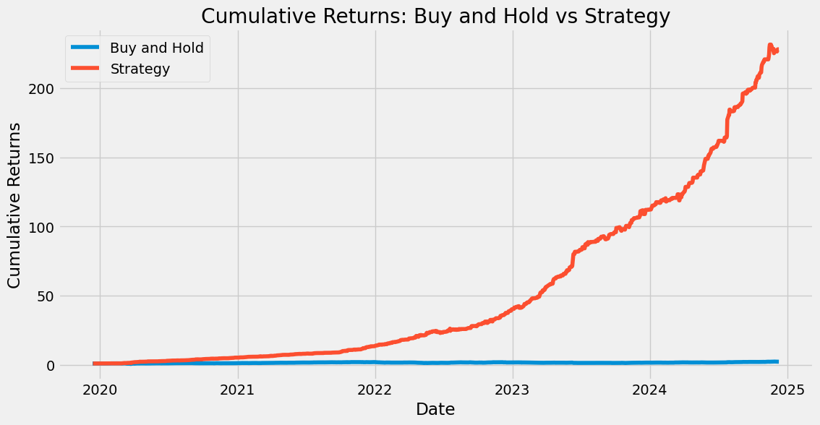
Notes:
1_CheatModel
2_Various Strategies

Slide 14
Random Forest Plot - “Cheat” Model
Analysis:
Strategy Return: x 228 (22806%)
Buy and Hold Return: x 2.3 (230%)
The machine learning strategy outperformed the buy-and-hold approach by 99 times.
Considerations:
Potential overfitting: The significant outperformance may indicate that the model is overfitted to the historical data.
Further validation needed: Run the model on test data and implement cross-validation techniques.
Notes:
Overfitting: The term "Overfit Model" suggests that the model might be overfitting to the training data, which may explain the discrepancy between its performance and simpler strategies.
Further Testing: Additional testing across different periods and market conditions would be required to assess the model's long-term viability.

Slide 15
Random Forest Plot - “Cheat” Model
Data Splitting (Training vs. Testing)
No Train Data Split (contains complete data up to the end of 2024)
No Test Data
All data is given to the model to optimize for the best trading possible
“Sees the future”
Model Training
#If closing price of tomorrow is higher than today then put 1 (buy) else put 0 (sell)
y = np.where(df['Close'].shift(-1) > df['Close'], 1, 0)
Notes:
1. Data Splitting (Training vs. Testing)
The dataset df is split into two parts: train_data_new (data up to the end of 2023) and test_data_new (data from 2024 onward).
This split is based on the index (presumably the date of the stock data), with training data being used to train the model, and testing data being used to evaluate its performance.
2. Feature Engineering
The features used to train the model are Open_minus_Close, High_minus_Low, and Close prices.
The target variable (y_train_new and y_test_new) is a binary classification based on whether the Close price of the next day (shift(-1)) is greater than today's Close price. If true, it is labeled as 1 (indicating a price increase), otherwise 0.
The target for the test set (y_test_new) is truncated to remove the last row because there is no "next day" value to predict for the final data point.
3. Model Training
A RandomForestClassifier is instantiated and trained using the features (X_train_new) and target (y_train_new) from the training data.
The model is trained on data up to 2023, using 100 trees in the forest (n_estimators=100).
4. Model Predictions
The trained model is used to predict the target variable (price movement) for the test data (2024).
The predictions are stored in the Overfit_Model_Predictions column of the test_data_new dataframe.
5. Return Calculations
Daily returns for 2024 are calculated as the percentage change in the closing price (pct_change()).
Buy-and-Hold Strategy: Assumes that the investor buys at the beginning of the period and holds throughout.
Cheat Model: The returns from an existing strategy (df['Strategy_Returns']) are used for comparison.
Overfit Model: This strategy assumes that predictions (from the Overfit_Model_Predictions) dictate whether to take a position (buy or sell). The return for the day is multiplied by the previous day's prediction (shifted by one day).
6. Performance Calculation
For each strategy (Buy_and_Hold, Cheat_Model, Overfit_Model), the total return for 2024 is calculated by multiplying the daily returns (adjusted by +1) and subtracting 1.
The result is stored in the returns_2024 dictionary.
7. Visualization of Cumulative Returns
The cumulative returns for each strategy are plotted over time, allowing a visual comparison of how each strategy performs throughout the year.
8. Strategy Performance Interpretation
The best and worst performing strategies are identified by comparing the total returns in returns_2024.
The "spread" between the best and worst performing strategies is calculated to understand the performance gap.
A detailed analysis and interpretation of the strategies' performance is generated. It includes the best and worst strategies, key considerations like model robustness and transaction costs, and conclusions about the effectiveness of the "Overfit Model."
Final Output (Example):
The output includes a detailed text interpretation of the strategy performance in 2024, with insights such as:
Best Strategy: Cheat_Model (103.19%)
Worst Strategy: Overfit_Model (20.89%)
Spread: 82.30% between the best and worst.
This provides insights into the relative performance of different strategies, and the effectiveness of the overfit model compared to traditional methods.
Key Considerations:
Overfitting: The term "Overfit Model" suggests that the model might be overfitting to the training data, which may explain the discrepancy between its performance and simpler strategies.
Further Testing: Additional testing across different periods and market conditions would be required to assess the model's long-term viability.

Slide 16
Random Forest Plot - Split Data
Data Splitting (Training vs. Testing)
train_data_new (data up to the end of 2023)
test_data_new (data from 2024 onward)
Model Training
RandomForestClassifier is instantiated and trained using the features (X_train_new) and target (y_train_new) from the training data.
Notes:
Data Splitting (Training vs. Testing)
The dataset df is split into two parts: train_data_new (data up to the end of 2023) and test_data_new (data from 2024 onward).
This split is based on the index (presumably the date of the stock data), with training data being used to train the model, and testing data being used to evaluate its performance.
Feature Engineering
The features used to train the model are Open_minus_Close, High_minus_Low, and Close prices.
The target variable (y_train_new and y_test_new) is a binary classification based on whether the Close price of the next day (shift(-1)) is greater than today's Close price. If true, it is labeled as 1 (indicating a price increase), otherwise 0.
The target for the test set (y_test_new) is truncated to remove the last row because there is no "next day" value to predict for the final data point.
Model Training
A RandomForestClassifier is instantiated and trained using the features (X_train_new) and target (y_train_new) from the training data.
The model is trained on data up to 2023, using 100 trees in the forest (n_estimators=100).
4. Model Predictions
The trained model is used to predict the target variable (price movement) for the test data (2024).
The predictions are stored in the Overfit_Model_Predictions column of the test_data_new dataframe.
5. Return Calculations
Daily returns for 2024 are calculated as the percentage change in the closing price (pct_change()).
Buy-and-Hold Strategy: Assumes that the investor buys at the beginning of the period and holds throughout.
Cheat Model: The returns from an existing strategy (df['Strategy_Returns']) are used for comparison.
Overfit Model: This strategy assumes that predictions (from the Overfit_Model_Predictions) dictate whether to take a position (buy or sell). The return for the day is multiplied by the previous day's prediction (shifted by one day).
6. Performance Calculation
For each strategy (Buy_and_Hold, Cheat_Model, Overfit_Model), the total return for 2024 is calculated by multiplying the daily returns (adjusted by +1) and subtracting 1.
The result is stored in the returns_2024 dictionary.
7. Visualization of Cumulative Returns
The cumulative returns for each strategy are plotted over time, allowing a visual comparison of how each strategy performs throughout the year.
8. Strategy Performance Interpretation
The best and worst performing strategies are identified by comparing the total returns in returns_2024.
The "spread" between the best and worst performing strategies is calculated to understand the performance gap.
A detailed analysis and interpretation of the strategies' performance is generated. It includes the best and worst strategies, key considerations like model robustness and transaction costs, and conclusions about the effectiveness of the "Overfit Model."
Final Output (Example):
The output includes a detailed text interpretation of the strategy performance in 2024, with insights such as:
Best Strategy: Cheat_Model (103.19%)
Worst Strategy: Overfit_Model (20.89%)
Spread: 82.30% between the best and worst.
This provides insights into the relative performance of different strategies, and the effectiveness of the overfit model compared to traditional methods.
Key Considerations:
Overfitting: The term "Overfit Model" suggests that the model might be overfitting to the training data, which may explain the discrepancy between its performance and simpler strategies.
Further Testing: Additional testing across different periods and market conditions would be required to assess the model's long-term viability.

Slide 17
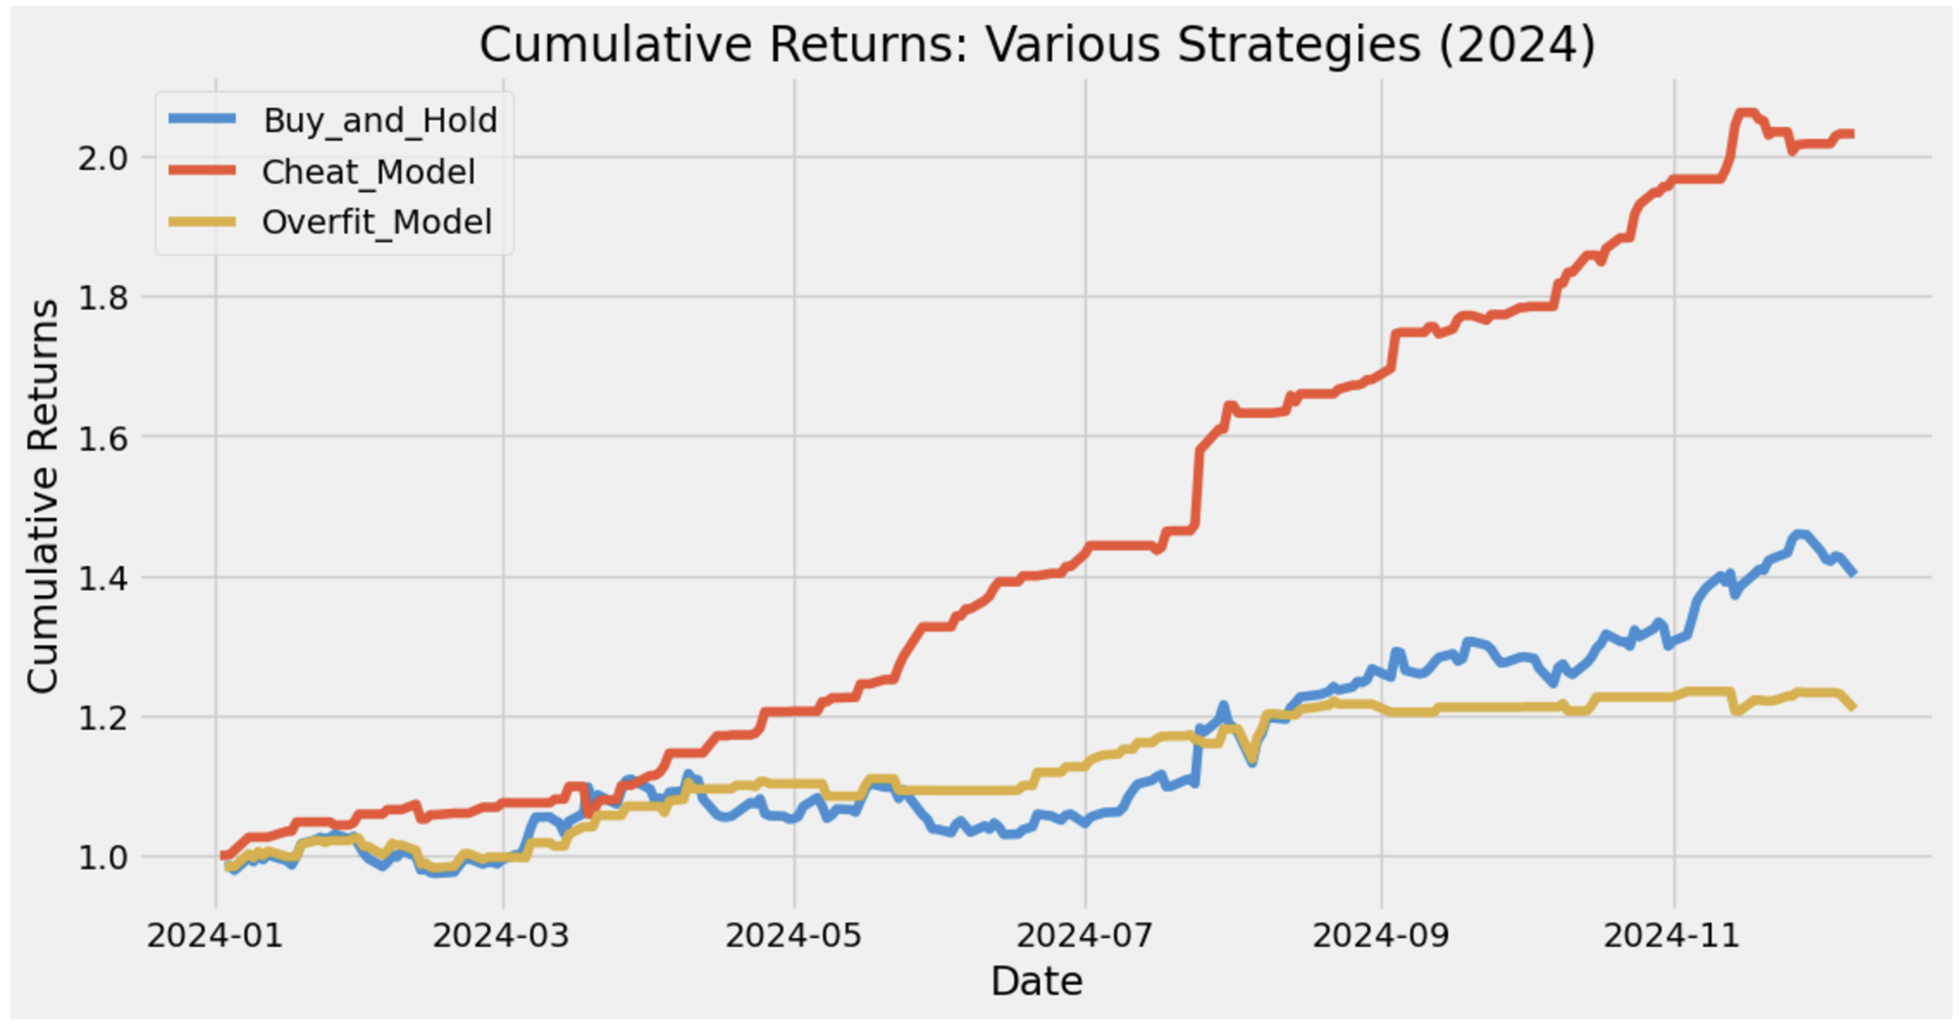
Notes:
This model starts from 1/2024 vs other model starts in 2019
Overfit model?

Slide 18
Strategy Performance Interpretation
Best Performing Strategy: Cheat_Model (103%)
Worst Performing Strategy: Overfit_Model (21%)
Spread between Best and Worst: 82%
Individual Strategy Returns:
Buy_and_Hold: 40.07%
Cheat_Model: 103.19%
Overfit_Model: 20.89%
Analysis
The performance spread between the best and worst strategies is significant.
Overfit model underperforms buy and hold.
Conclusion
The yellow line exemplifies what how an overfit model performs when exposed to test data. This model is not predictive.

Slide 19
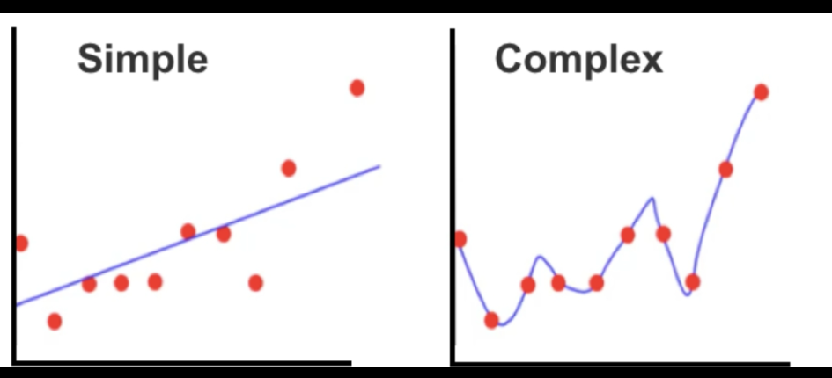
Overfitting Explained

Slide 20
Transition to LSTM (Long Short-Term Memory Network)
Rationale:
Stock market data is sequential, time-dependent, and well-suited for LSTM models.
Added Technical Analysis (TA) indicators to enrich input features.
Feature Engineering:
Popular indicators like SMA, EMA, RSI, MACD, and 52-week high/low ratios were incorporated to capture trends, momentum, and volatility.
from ta.trend import SMAIndicator, EMAIndicator, MACD
from ta.momentum import RSIIndicator

Slide 21
Long short-term memory (LSTM) vs Buy and Hold
This model is a time-series prediction model using stock prices and various technical indicators to predict the closing price.
Technical Analysis (TA)
Simple Moving Averages (SMA): SMA over 20 and 50 days.
Exponential Moving Average (EMA): EMA over 20 days.
Relative Strength Index (RSI): A momentum indicator that measures the speed and change of price movements.
MACD (Moving Average Convergence Divergence): A trend-following momentum indicator.
52-Week High and Low Ratios: Used as a measure of how close the current price is to its highest or lowest value in the past year.
Notes:
This code implements two versions of a deep learning model (LSTM) for predicting financial asset prices, specifically stock prices, using historical data. It includes a detailed process for feature engineering, data preparation, model training, and evaluation. Here's a breakdown of its key sections:
### 1. **Libraries and Dependencies**:
- **Data Handling**: `numpy`, `pandas` are used for data manipulation.
- **Plotting**: `matplotlib.pyplot` is used for visualizing the results.
- **Preprocessing**: `MinMaxScaler` from `sklearn` scales the data.
- **Deep Learning**: `tensorflow.keras` is used to build the LSTM model.
- **Technical Analysis**: `ta` library is used to compute technical analysis indicators like SMA, EMA, RSI, MACD, and more.
### 2. **Data Loading and Feature Engineering**:
- **Load Data**: The code loads a CSV file containing stock data with a `Date` column as the index. It assumes the data includes columns like `Open`, `High`, `Low`, `Close`, and `Volume`.
- **Add Features**: Several technical analysis features are computed using the `ta` library:
- **SMA**: 20-day and 50-day Simple Moving Averages.
- **EMA**: 20-day Exponential Moving Average.
- **RSI**: Relative Strength Index, a momentum indicator.
- **MACD**: Moving Average Convergence Divergence indicator and its signal line.
- **52-week High/Low Ratios**: These ratios show how close the current closing price is to the highest and lowest prices over the past year (252 trading days).
- These features are appended to the original data, and `dropna()` removes rows with missing values.
### 3. **Data Preparation**:
- **Split the Data**: The data is split into `train_data` (before 2024-01-01) and `test_data` (from 2024-01-01 onwards).
- **Scaling**: A `MinMaxScaler` is applied to scale the features between 0 and 1, ensuring better performance of the LSTM model.
- **Sequence Creation**: The function `create_sequences` is used to create sequences of `seq_length` (60 time steps). This is necessary for training LSTM models, which require time-series data in a sequence format.
- `X_train` and `y_train` are the training data inputs and targets (close prices), and `X_test` and `y_test` are for testing.
### 4. **LSTM Model**:
- **Model Architecture**: The LSTM model is constructed using `tensorflow.keras`:
- **LSTM Layers**: Two LSTM layers with 50 units each. The first one returns sequences (`return_sequences=True`), while the second one does not.
- **Dropout**: Dropout layers with a rate of 0.2 to reduce overfitting.
- **Dense Layer**: A final dense layer outputs a single value, the predicted `Close` price.
- **Compilation**: The model is compiled using the Adam optimizer with a learning rate of 0.001 and Mean Squared Error (`mse`) as the loss function.
- **Training**: The model is trained for 10 epochs with a batch size of 32, using 20% of the data for validation.
### 5. **Predictions and Performance Metrics**:
- **Predictions**: The model predicts stock prices on the test set (`X_test`). These predictions are then inverse transformed to obtain actual price predictions on the original scale.
- **Returns Calculation**:
- The returns are calculated as the percentage change of the actual and predicted stock prices (`pct_change()`).
- A trading strategy is simulated where the model "buys" (1) when the next predicted price is higher and "sells" (-1) otherwise.
- The model's returns are calculated by multiplying the returns with the model positions.
- **Cumulative Returns**: The cumulative returns of the "Buy and Hold" strategy (simple return over time) and the model's trading strategy are computed and plotted.
- **Performance Comparison**: Finally, the cumulative returns are compared, and the total returns for both the LSTM model and a basic buy-and-hold strategy are printed.
### 6. **Visualization**:
- **Plot**: A plot is created showing the cumulative returns for both the LSTM model and the buy-and-hold strategy, visually comparing the performance of the model with a simple investment approach.
### 7. **Second Model ("Inferior LSTM")**:
- A second version of the model is introduced as a comparison, with fewer features (no technical analysis indicators like SMA, EMA, RSI, MACD) and the focus is on using the `52W_High_Ratio` and `52W_Low_Ratio` as features. This version is expected to underperform due to fewer input features.
- The same training, prediction, and evaluation steps are applied to this model.
- The cumulative returns for this "inferior" LSTM model are also compared with the buy-and-hold strategy.
### 8. **Results**:
- **LSTM Model Performance**: For both versions, the model's return is compared to the buy-and-hold return. For the first LSTM model, the cumulative return is 40.92%, outperforming the buy-and-hold return of 28.59%.
- The second (less-featured) LSTM model achieves a smaller return (29.07%) compared to buy-and-hold, which suggests that removing the technical analysis features reduces the model's performance.
### Conclusion:
This code demonstrates how to create a machine learning model for financial forecasting using LSTM networks and various technical indicators. The process includes feature engineering, data scaling, model training, evaluation, and performance comparison with traditional buy-and-hold strategies. The key insight is that incorporating more technical indicators generally improves model performance, as shown by the higher returns of the first LSTM model compared to the "inferior" version.

Slide 22
Independent Variables X
Simple Moving Average (SMA)
SMA_20: Captures short-term price trends.
SMA_50: Reflects medium-term trend behavior for stronger signals.
Exponential Moving Average (EMA)
EMA_20: Focuses on short-term price responsiveness, improving prediction accuracy during volatile periods.

Slide 23
Independent Variables X cont.
Relative Strength Index (RSI)
RSI measures the speed and magnitude of price changes, indicating whether an asset is overbought (>70) or oversold (<30). It helps identify momentum shifts.
How this assists the model: Enhances the model’s ability to predict turning points where prices may bounce or correct.
Moving Average Convergence Divergence (MACD)
MACD: Measures the difference between EMAs to identify momentum strength.
MACD_Signal: A smoothed version to pinpoint crossover signals (buy/sell opportunities).
52W_High_Ratio and 52W_Low_Ratio
Incorporates market activity data to validate price movements and strengthen predictions.

Slide 24
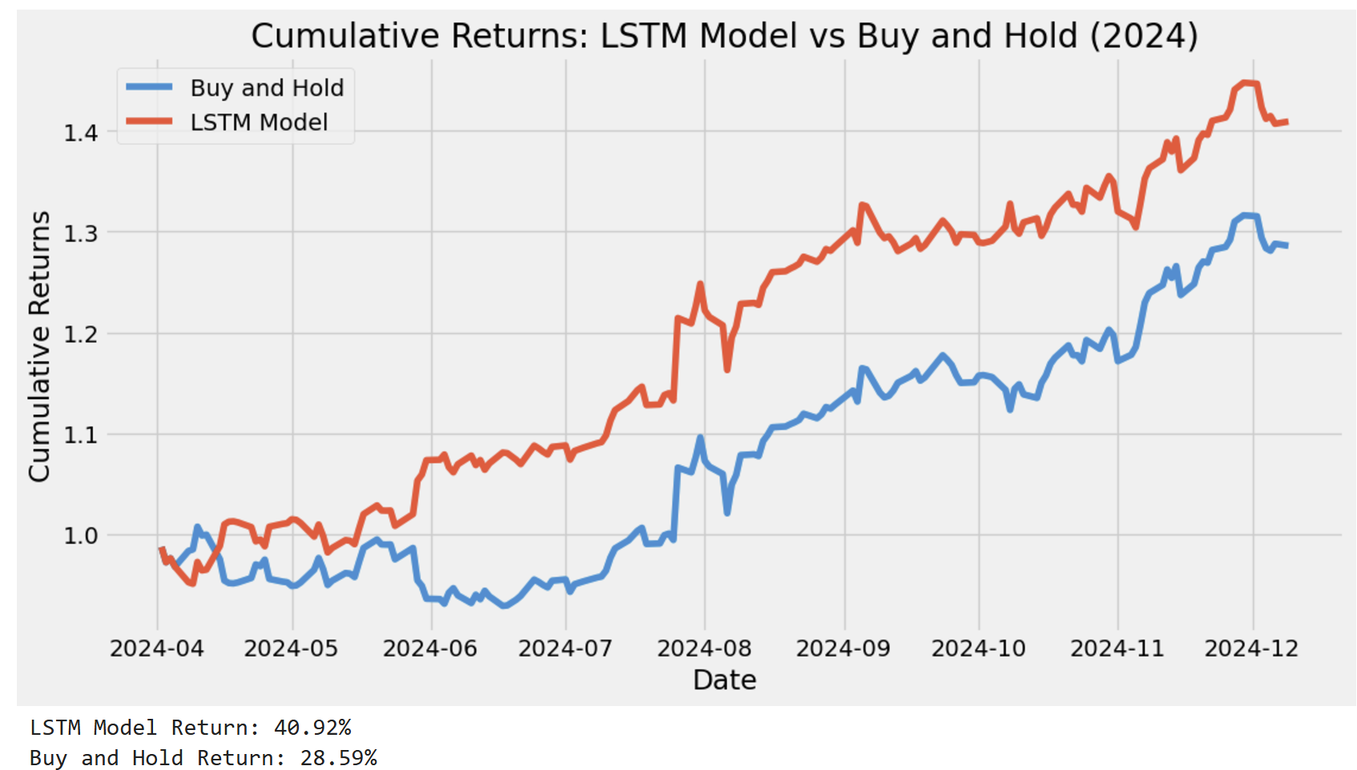
Notes:
3_LSTM
This code implements a financial forecasting model using a Long Short-Term Memory (LSTM) neural network to predict stock prices based on historical data and technical indicators. Here's a breakdown of what each part of the code does:
### 1. **Import Libraries**
- `numpy`, `pandas`, `matplotlib.pyplot`: For numerical operations, data manipulation, and plotting.
- `sklearn.preprocessing.MinMaxScaler`: To scale the data values between 0 and 1 for LSTM processing.
- `tensorflow.keras`: For building and training the LSTM model.
- `ta.trend` and `ta.momentum`: Libraries from the `ta` package to compute technical indicators like Simple Moving Average (SMA), Exponential Moving Average (EMA), Relative Strength Index (RSI), and MACD (Moving Average Convergence Divergence).
### 2. **Loading and Preprocessing Data**
- The stock data is loaded from a CSV file using `pd.read_csv()`, where the `Date` column is parsed as a datetime and set as the index.
- **`add_features()` function**: Calculates several technical analysis indicators:
- **SMA (Simple Moving Average)** for 20 and 50 days.
- **EMA (Exponential Moving Average)** for 20 days.
- **RSI (Relative Strength Index)**, a momentum indicator.
- **MACD (Moving Average Convergence Divergence)** and its signal line.
- **52-Week High and Low**, and their ratios to the current price.
- These technical indicators are added to the DataFrame as additional features.
### 3. **Data Preparation**
- **Feature Selection**: The code selects a set of features to feed into the model, including price, volume, and technical indicators.
- **Splitting Data**: The data is split into `train_data` (before January 2024) and `test_data` (January 2024 and beyond).
- **Scaling**: A `MinMaxScaler` is used to scale the selected features so that values lie between 0 and 1. The scaling is applied to both the training and testing data.
### 4. **Preparing Sequences for LSTM**
- **`create_sequences()` function**: Converts the data into sequences of a specified length (`seq_length` = 60). Each sequence consists of `seq_length` time steps of features to predict the next value of the 'Close' price (which is the target variable).
- This is important for LSTM models, as they are designed to process sequential data.
### 5. **Building the LSTM Model**
- **Model Structure**:
- Two LSTM layers are used, both followed by Dropout layers to prevent overfitting.
- The output layer is a `Dense(1)` layer that predicts the future value of the 'Close' price.
- **Compilation**: The model is compiled with the Adam optimizer and Mean Squared Error (MSE) as the loss function, which is typical for regression problems.
- **Training**: The model is trained for 10 epochs with a batch size of 32. A validation split of 0.2 is used, meaning 20% of the training data is used for validation.
### 6. **Making Predictions**
- After training, the model predicts the stock prices for the test set.
- The predictions are then inverse-transformed (i.e., scaled back to the original price range using `scaler.inverse_transform()`).
- The actual and predicted prices are compared.
### 7. **Performance Metrics**
- **Returns Calculation**:
- The percentage change in the actual 'Close' prices (`test_returns`) is calculated.
- The model's positions are determined based on whether the predicted price is increasing or decreasing (`model_positions`).
- Model returns are calculated by multiplying the actual returns by the model's positions.
- **Cumulative Returns**: Cumulative returns are calculated for both the "Buy and Hold" strategy (buying and holding the stock throughout the period) and the LSTM model's strategy (based on the model's predictions).
### 8. **Visualization**
- A plot is generated to visualize the cumulative returns of both the "Buy and Hold" strategy and the LSTM model, showing how well the model performs relative to simply holding the stock over time.
### 9. **Performance Output**
- The total return of both the LSTM model and the Buy and Hold strategy is printed, showing how much profit (or loss) each strategy would have generated over the test period.
### Key Insights:
- **LSTM Model**: A deep learning approach is used to predict future stock prices based on historical data and technical indicators. The model learns patterns in the data and can be used for making trading decisions.
- **Technical Indicators**: The model incorporates several commonly used technical indicators, such as SMA, EMA, RSI, and MACD, which are often used in trading strategies to predict market trends.
- **Returns Comparison**: The code evaluates the performance of the LSTM model by comparing its returns to a simple Buy and Hold strategy, offering insight into whether the model provides value over just holding the stock.
### Summary:
This code is a financial forecasting system that uses an LSTM model to predict stock prices based on historical data and technical analysis indicators. It evaluates the model's performance by comparing its predicted returns to the returns from a simple Buy and Hold strategy, providing a way to assess the model's usefulness for trading decisions.

Slide 25
LSTM Model - Train Test split
Data Splitting (Training vs. Testing)
Training/Test split retained: Training up to 2023, testing in 2024.
train_data = df[df.index < '2024-01-01']
test_data = df[df.index >= '2024-01-01']
MinMaxScaler was used for normalization.
scaler = MinMaxScaler()
Sequence Length: 60 time steps
Model Training / Design
Sequential is instantiated and trained using the features (x-BLANK) and target (y-BLANK) from the training data.
A 2-layer LSTM model with dropout regularization to reduce overfitting.
Sequences of 60 time steps provided to the model as input.
Notes:
Model Summary
Train-Test Split:
Training: Data up to 2023
Testing: Data from 2024 onward
Normalization: MinMaxScaler applied to features and target.
Sequence Length: 60 time steps.
LSTM Model:
Layers: 2 LSTM layers with 50 units each.
Regularization: Dropout layers with a rate of 0.2.
Output: 1 Dense layer for predicting the target variable.
Loss Function: Mean Squared Error (MSE).
Optimizer: Adam.

Slide 26
Model Success Attribution
How can we determine that this was not by random chance?
How do we audit the functionality of the technical indicators?

Slide 27
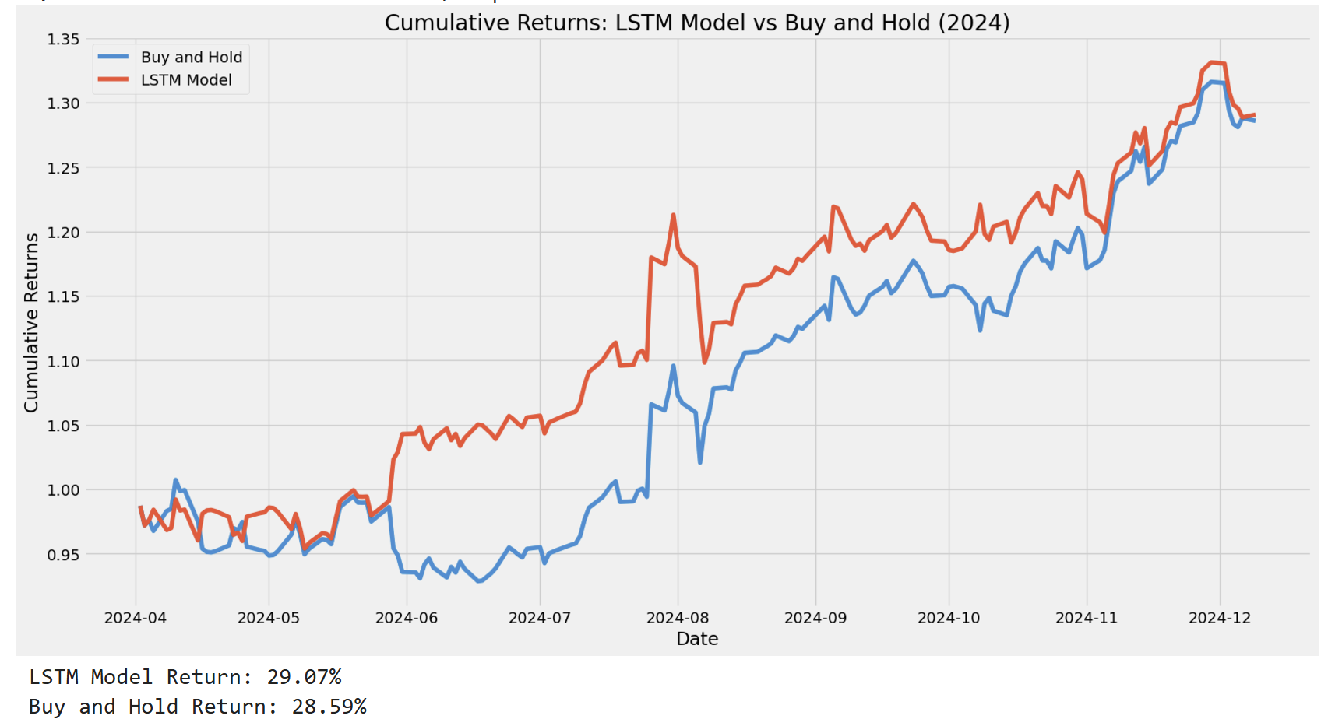
Notes:
4_inferior_LSTM
Same as 3_LSTM but deleted features

Slide 28
Financial Indicators are the key
How do we optimize the model without cheating?
The key is the weights of the financial indicators.
Pre-Optimization
The hyperparameter tuning (e.g., LSTM units, dropout rates, and learning rate) was fixed and manually chosen.
No hyperparameter search strategy—likely led to suboptimal model performance.
Grid Search?
Random Regression?
Optuna?
Notes:
No hyperparameter search strategy—likely led to suboptimal model performance.

Slide 29
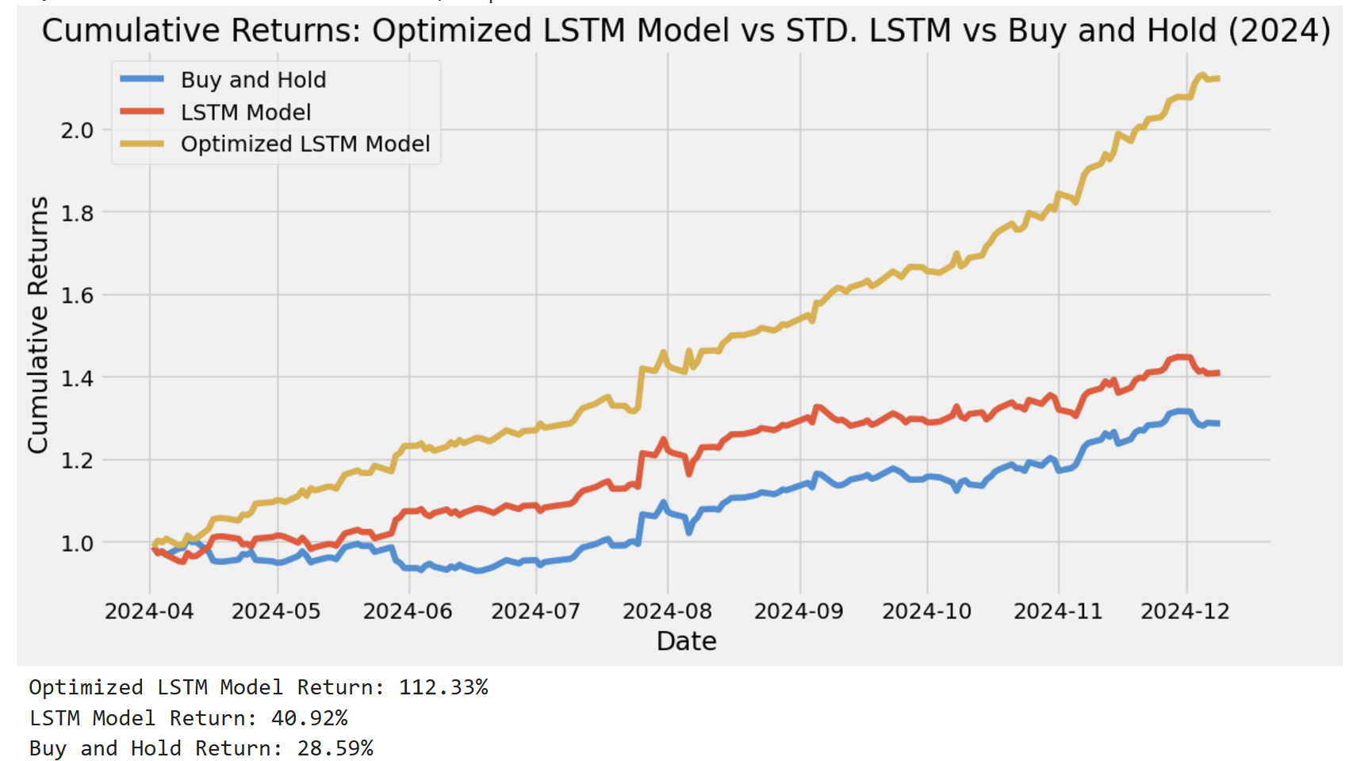
Notes:
5_optimized LSTM
#Golden Magic Model
### Overview of the Golden Magic Model:
The Golden Magic Model appears to be a deep learning-based time series forecasting model, primarily designed for stock market prediction, focusing on predicting the "Close" price of a given asset (e.g., a stock). The model combines technical indicators with deep learning (LSTM - Long Short-Term Memory networks) to forecast future prices based on past data.
### Key Components of the Model:
1. **Feature Engineering**:
The model employs a set of technical indicators commonly used in financial analysis:
- **SMA (Simple Moving Average)**: Two periods are used, 20 and 50 days.
- **EMA (Exponential Moving Average)**: Uses a 20-day period.
- **RSI (Relative Strength Index)**: A momentum oscillator to gauge overbought/oversold conditions.
- **MACD (Moving Average Convergence Divergence)**: Indicates changes in momentum.
- **52-week high/low ratio**: Helps assess the relative position of the current price within its yearly range.
These indicators are added as new features to the data to aid in the prediction of future stock prices.
2. **Data Preprocessing**:
- **Scaling**: The data is scaled using the `MinMaxScaler` to ensure that all features lie within the same range, improving the model's performance.
- **Sequence Creation**: The model takes a sequence of 60 previous time steps (closing prices and indicators) to predict the next closing price. This is a typical setup for time series forecasting tasks.
3. **Model Architecture**:
- **LSTM Layers**: The core of the model is an LSTM-based architecture, which is capable of learning temporal dependencies in sequential data.
- The model consists of two LSTM layers, with the number of units and the dropout rate being optimized via Optuna hyperparameter optimization.
- **Dropout Layers**: Dropout layers are used to prevent overfitting by randomly setting a fraction of the input units to 0 during training.
- **Dense Layer**: The final output layer has a single neuron, which predicts the "Close" price for the next time step.
Hyperparameters like the number of LSTM units, dropout rates, and learning rate are tuned using **Optuna**, an optimization framework that helps find the best set of parameters by evaluating different combinations of hyperparameters.
4. **Custom Callback for Feature Weighting**:
The model includes a custom Keras callback (`FeatureOptimizationCallback`) that adjusts the feature weights during training. This callback is designed to assign varying importance to each feature during the model's training process, potentially improving the model's focus on the most relevant features for predicting stock prices.
5. **Training and Evaluation**:
- The model is trained using **Mean Squared Error (MSE)** as the loss function, which is typical for regression tasks like price prediction.
- **Validation Loss**: The model uses validation loss to monitor its generalization performance.
- **Epochs**: The model is trained for 15 epochs, with the training progress monitored for each epoch.
- **Optuna Grid Search**: The model's hyperparameters are optimized using Optuna's trial-based optimization. During each trial, the model is trained for a few epochs, and the validation loss is recorded. The best parameters found through this process are then used to train the final model.
6. **Model Performance**:
- The model’s validation loss over epochs is tracked. For example, at Epoch 1, the training loss starts at 0.0848 and drops to 0.0042 by the second epoch, showing rapid learning.
- Feature weights are updated after each epoch based on the performance of the model and the importance of each feature, showing how the model adapts to the data as training progresses.
### Observations:
- The **Optuna Optimization** results show that the best hyperparameters for the model were:
- **LSTM units (first layer)**: 99
- **LSTM units (second layer)**: 67
- **Dropout rate (first layer)**: 0.1501
- **Dropout rate (second layer)**: 0.1923
- **Learning rate**: 0.00193
These settings seem to provide the lowest validation loss, indicating that these hyperparameters might offer the best predictive performance.
- **Feature Weight Adjustments**: The feature importance is dynamically adjusted during training, as seen in the callback’s logs. The features' weights change throughout the epochs, which can help the model focus on more important signals over time.
- **Loss Function Behavior**: The loss function steadily decreases, indicating that the model is learning from the data and improving its predictions as training progresses.
### Conclusion:
The Golden Magic Model represents a sophisticated stock prediction framework, combining the power of LSTM networks with financial technical indicators and advanced optimization techniques like Optuna for hyperparameter tuning. The inclusion of feature weighting allows the model to adapt to varying levels of feature importance throughout training, potentially boosting its ability to generalize to new data. This combination of deep learning with traditional financial analysis could offer an edge in forecasting market trends.

Slide 30
Post-Optimization |Optuna Integration
Hyperparameters are optimized dynamically using Optuna, an advanced optimization framework.
Optuna uses a smarter "pruning" strategy with Trial-based evaluations. It stops unpromising models early, saving time and computation.
Optuna > Gridsearch
GridSearch explores every combination of hyperparameters in a grid.
Optuna combines random sampling and pruning
Notes:
ML Theory Implications:
GridSearch: Exhaustive search but computationally expensive. GridSearch explores every combination of hyperparameters in a grid, making it impractical for large search spaces.
Optuna: Combines random sampling and pruning to find optimal hyperparameters quickly. Adaptive searching balances exploration (searching the space) and exploitation (focusing on promising regions).
Data Leakage Risk
Why it happens: The callback dynamically updates feature weights during training, potentially learning information indirectly from the validation set. This violates the principle that the validation set should remain unseen during model training.
Impact: Data leakage inflates validation performance metrics and creates an illusion of better generalization.
Correction: Split the data into:
Training set: Used for learning weights and model training.
Validation set: Used for Optuna's hyperparameter optimization and feature weight adjustments.
Test set: Completely unseen data to evaluate the final model performance.

Slide 31
Challenges
Future Considerations
Synthetic Data Bias: Simulated responses may not represent real-world complexity.
Scalability: Fine-tuning large models on vast datasets.
Integrate real investor data for improved realism.
Incorporate advanced deep learning models (e.g., GPT variants).
Add metrics like Sharpe Ratio for portfolio performance.
Enhance chatbot interface for better usability.
Notes:
Jonathan
Dollar-cost averaging (DCA): investing the same amount of money in a target security at regular intervals over a certain period of time, regardless of price
Challenges:
One of the challenges we face is the bias introduced by synthetic data. Since we’re relying on simulated responses to train our models, there’s a risk that these responses may not fully capture the real-world complexity of investors. For example, real investors may have more nuanced or emotional responses to risk than what we can simulate. This could affect the accuracy of our risk tolerance predictions and, in turn, the portfolio recommendations
Another challenge we’re addressing is scalability. As we increase the size of the datasets we use—such as more investor responses or market data—fine-tuning our large models becomes increasingly complex. It requires powerful computational resources, and we must ensure the model can scale without sacrificing accuracy or becoming too slow to be practical for real-time use
Future Considerations:
Looking ahead, one of our key goals is to integrate real investor data into our models. By using actual responses from investors, we can improve the realism of our predictions. This would lead to more accurate assessments of risk tolerance and better-aligned portfolio recommendations.
We also learned that we can further incorporate advanced deep learning models, such as GPT variants, to improve our ability to interpret investor responses. These models can understand and generate language in a much more sophisticated way, helping us to better classify risk tolerance based on subtle language cues that may be missed by simpler models
In the future, we could also include metrics like the Sharpe Ratio to evaluate portfolio performance. The Sharpe Ratio measures the risk-adjusted return, which helps investors understand how well their portfolios are performing relative to the level of risk they’re taking on. By incorporating this metric, we can provide more well-rounded recommendations
Lastly, we’re focusing on improving the chatbot interface for better usability. A more intuitive and responsive interface will make it easier for users to interact with the system and receive personalized recommendations. This will ensure that even non-technical users can engage with the system comfortably

Slide 32
Conclusion
Summary: Machine learning provides innovative tools for personalized financial advice
More accurate predictions and tailored investment strategies
Impact:
Empowers investors to align portfolios with their unique risk profiles
Optimizes investment decisions and enhances overall portfolio performance
Next Steps:
Scale to broader datasets to improve model accuracy and robustness
Refine algorithms for better predictions across different financial instruments and market conditions

Slide 33
Thank you!!
Questions?

Slide 34
Addressing challenges
Risk of Data Leakage
Train-Validation-Test Split Missing

